Slide 1
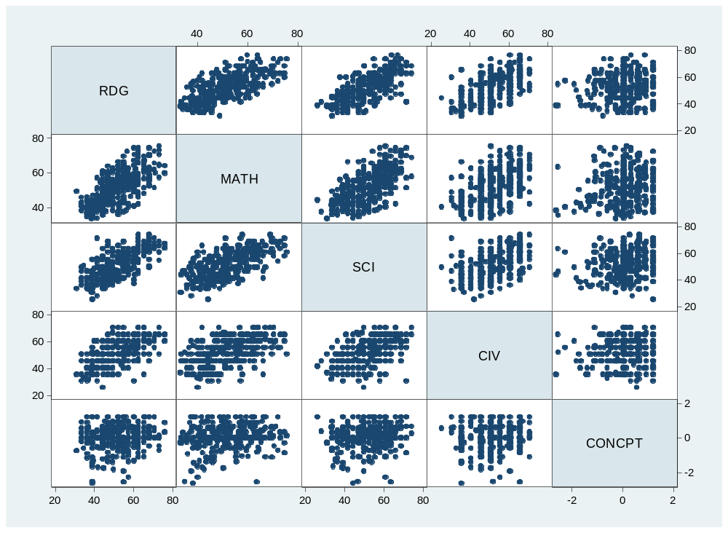
What’s the correlation?

Slide 2
What’s the correlation?

Slide 3
What’s the correlation?
.69

Slide 4
What’s the correlation?

Slide 5
What’s the correlation?
.68

Slide 6
What’s the correlation?

Slide 7
What’s the correlation?
.60

Slide 8
What’s the correlation?

Slide 9
What’s the correlation?
.13

Slide 10
What’s the correlation?

Slide 11
What’s the correlation?
.65

Slide 12
What’s the correlation?

Slide 13
What’s the correlation?
.51

Slide 14
What’s the correlation?

Slide 15
What’s the correlation?
.16

Slide 16
What’s the correlation?

Slide 17
What’s the correlation?
.51

Slide 18
What’s the correlation?

Slide 19
What’s the correlation?
.15

Slide 20
What’s the correlation?

Slide 21
What’s the correlation?
.06

Slide 22
Rounded, the mean reading score is 52 and sd=10 and the mean math score is also 52 and sd=10. If a given student’s reading score is 67, then what is your best estimate of her math score?
.69

Slide 23
In predicting someone’s math score, if you could have just one piece of information, and it is either (a) her reading score, or (b) her self concept score, which would you rather have? What’s it worth to you?
.69
.16

Slide 24
Explain to a non-statistician what it means to say “reading and math scores are correlated r=.69 in this population”.
.69

Slide 25
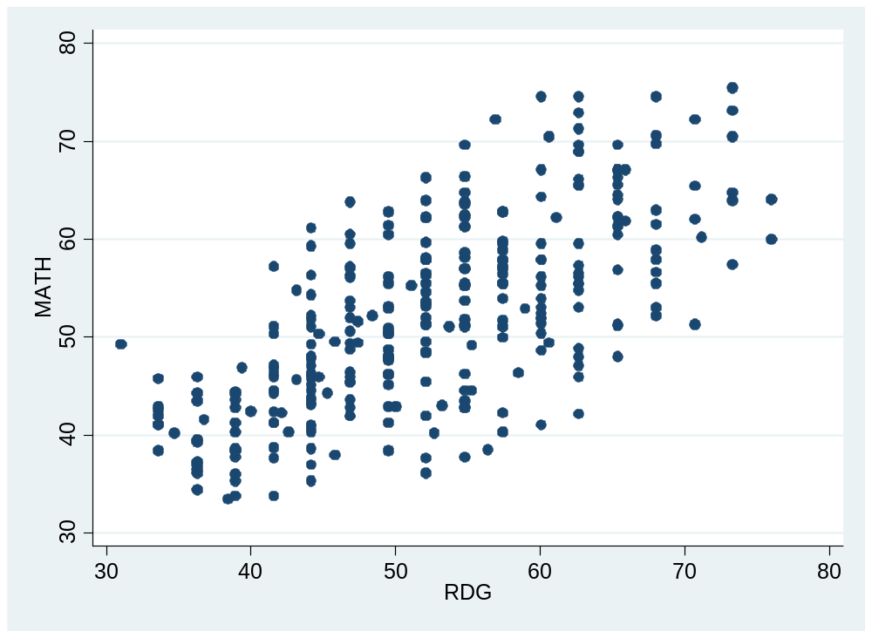

Slide 26
